Slide 1




Credit Risk Analysis using Machine learning techniques & tableau
By
Indraja Bandla
Data scientist

Slide 2
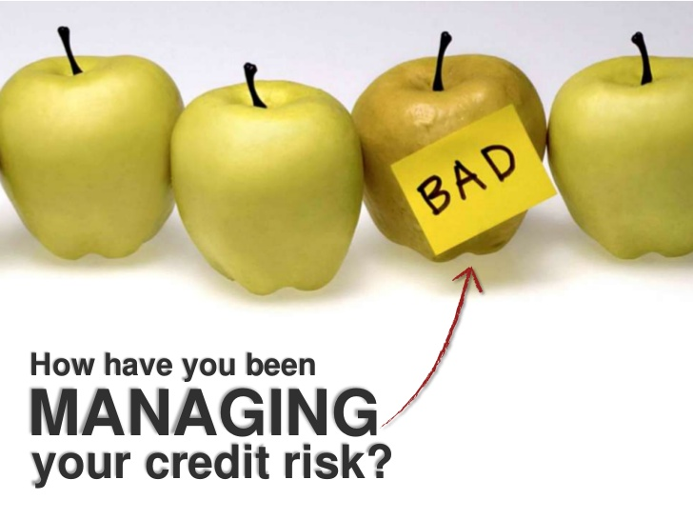
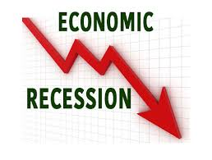
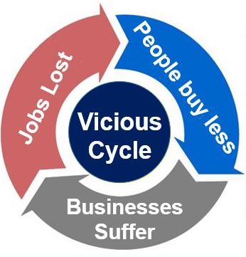

Credit Risk Analysis
What is it?
Why do you need it?
Who wants it?
What motivates me to take this as a capstone?

Slide 3
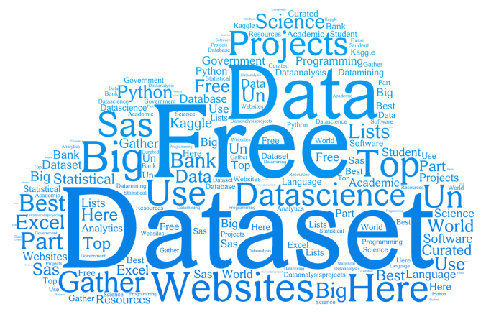
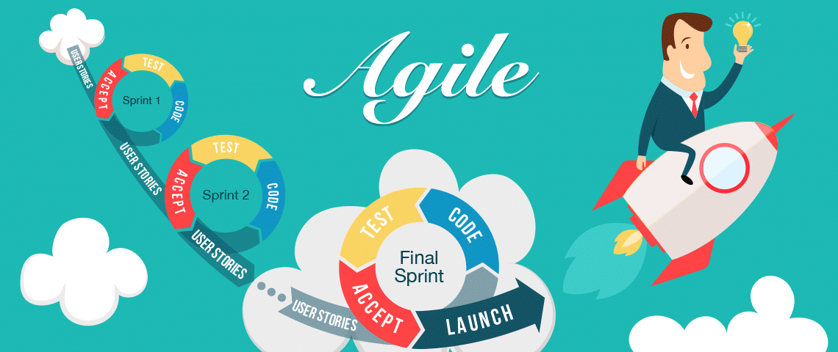


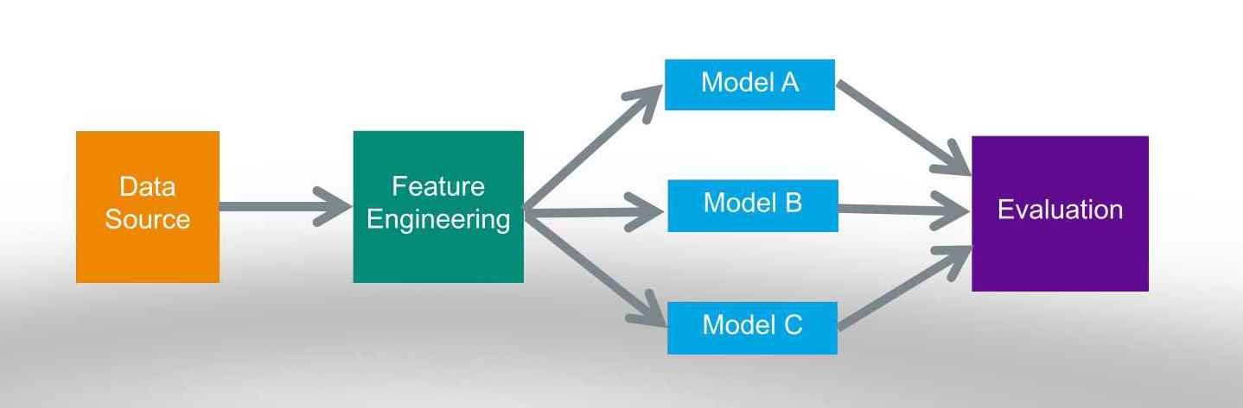
Journey
Hunt for dataset
Data cleaning
SWOT
Agile

Slide 4
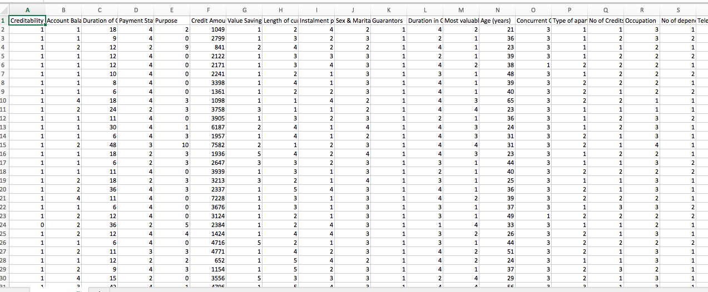

Exploratory Data Analysis
German Credit data with 1000 instances
To decide whether borrower is good credit/bad credit. I considered their 20 attributes
Economical status : Account Balance , Value savings/stocks, Most valuable asset
Personal status :Sex and Marital Status, No of dependents, Type of Apartment, Duration in current address, Duration of credit, Age, Guarantors, Occupation ,Length of current employment, Foreign worker, Telephone, Purpose
History :No. of credits at this bank, Concurrent credits
Other factors :Installment %, duration of credit
They are not much correlated
This is Multivariate non-graphical — analysis of multiple variables at the same time.
What’s the solution???

Slide 5
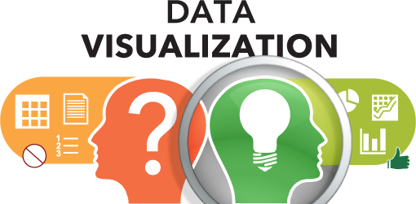
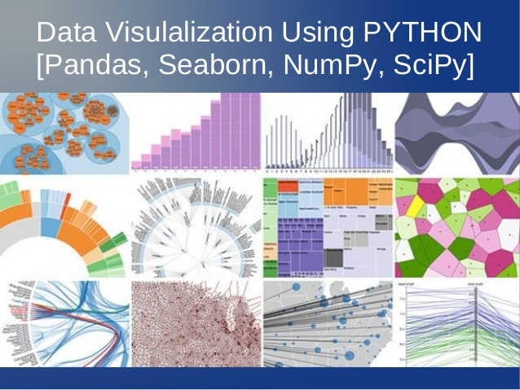
“A picture is worth a million rows”
Tableau

Slide 6
Findings & Solutions
Model | Motto | Accuracy(lasso picked features) | Accuracy(Logistic top 20 features)
Logistic | Accuracy | 78.8 | 76.8
Decision Trees | Short application Form | 73.5 | 74.1
Know your nearest Neighbor(KNN) | Quick and clear | 72.49 | 72.6
Random Forest | When some data is missing | 78.5 | 77
Ada Boosting | Use with other algorithms to improve their performance | 73 | 71.5
Support Vector Machine(SVM) | For group of features | 77.2 | 75.45
The Roc curve is performing better with Logistic with an area of 0.85
It is completely depends on the company to choose which model they want
Be specific to your goal!!know what bank wants..... Be wise to select the model based on that !!!

Slide 7

Lessons learnt
Data visualization is the best way
Cross Validation is very critical
model needs to be tuned at a much more granular level
Following an Agile parallel process for maximizing the success
Notice that accuracy changes with test size
Along with accuracy, False negativity and False Positivity also matters (Bank looses loyal customers and bank may face risk giving loan to bad credit)
"Experience is the good teacher”
"Collaboration makes you better competitor"

Slide 8

Want to do more . just noted down few things that came to my mind
Tune the parameters for Deep Learning and compare the predictive accuracy and performance against Stacking / Voting models
Explore the possibility of adding new polynomial and transformed features, and evaluate the predictive accuracy.
Try Bayesian model against frequentist theories
Explore ! Explore !! Explore !!!

Slide 9
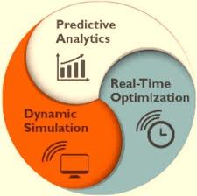
Unraveling Real-Time Predictive Analytics
How to deploy in production? | What to do after deployment?
SAS®Data Integration Studio-to read model definitions from SAS Model Manager run ad-hoc by the modeling or IT staff-for a direct marketing campaign operational or transaction handling system-application score model | MONITOR THE MODEL Automate the monitoring tasks Notify interested parties Track input and output variable distribution shifts Provide monitoring trend charts or reports

Slide 10
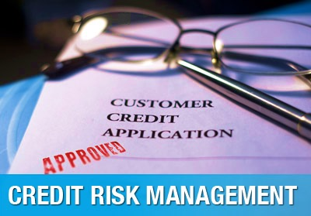
Conclusion
A credit scoring model is just one of the factors used in evaluating a credit application. Assessment by a credit expert remains the decisive factor.
For more details ,Check my blog https://indu4191.blogspot.com.au/

